Slide 1
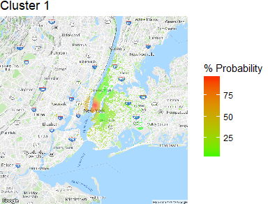
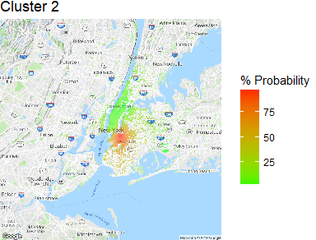
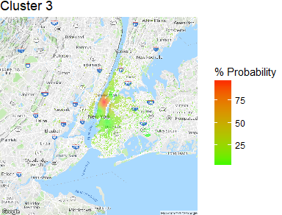

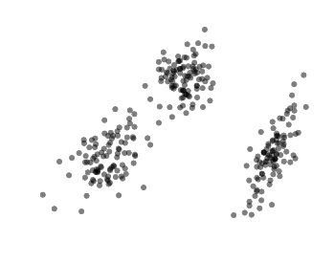
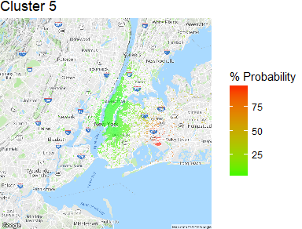
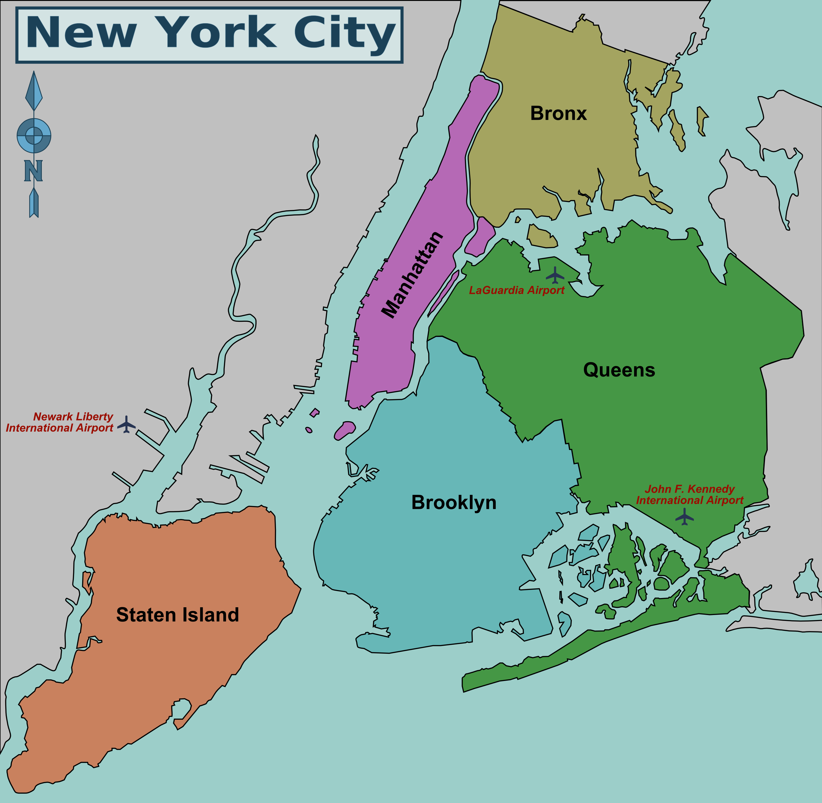
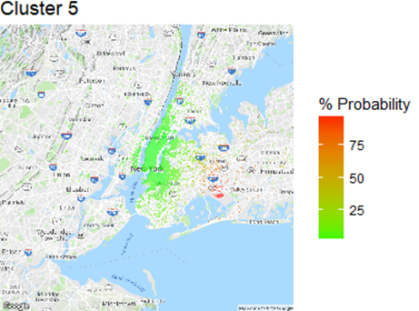
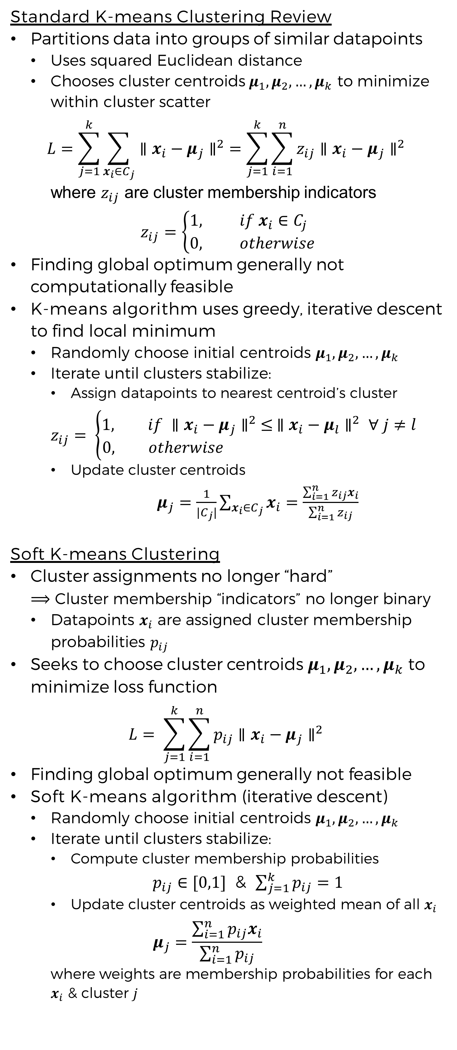
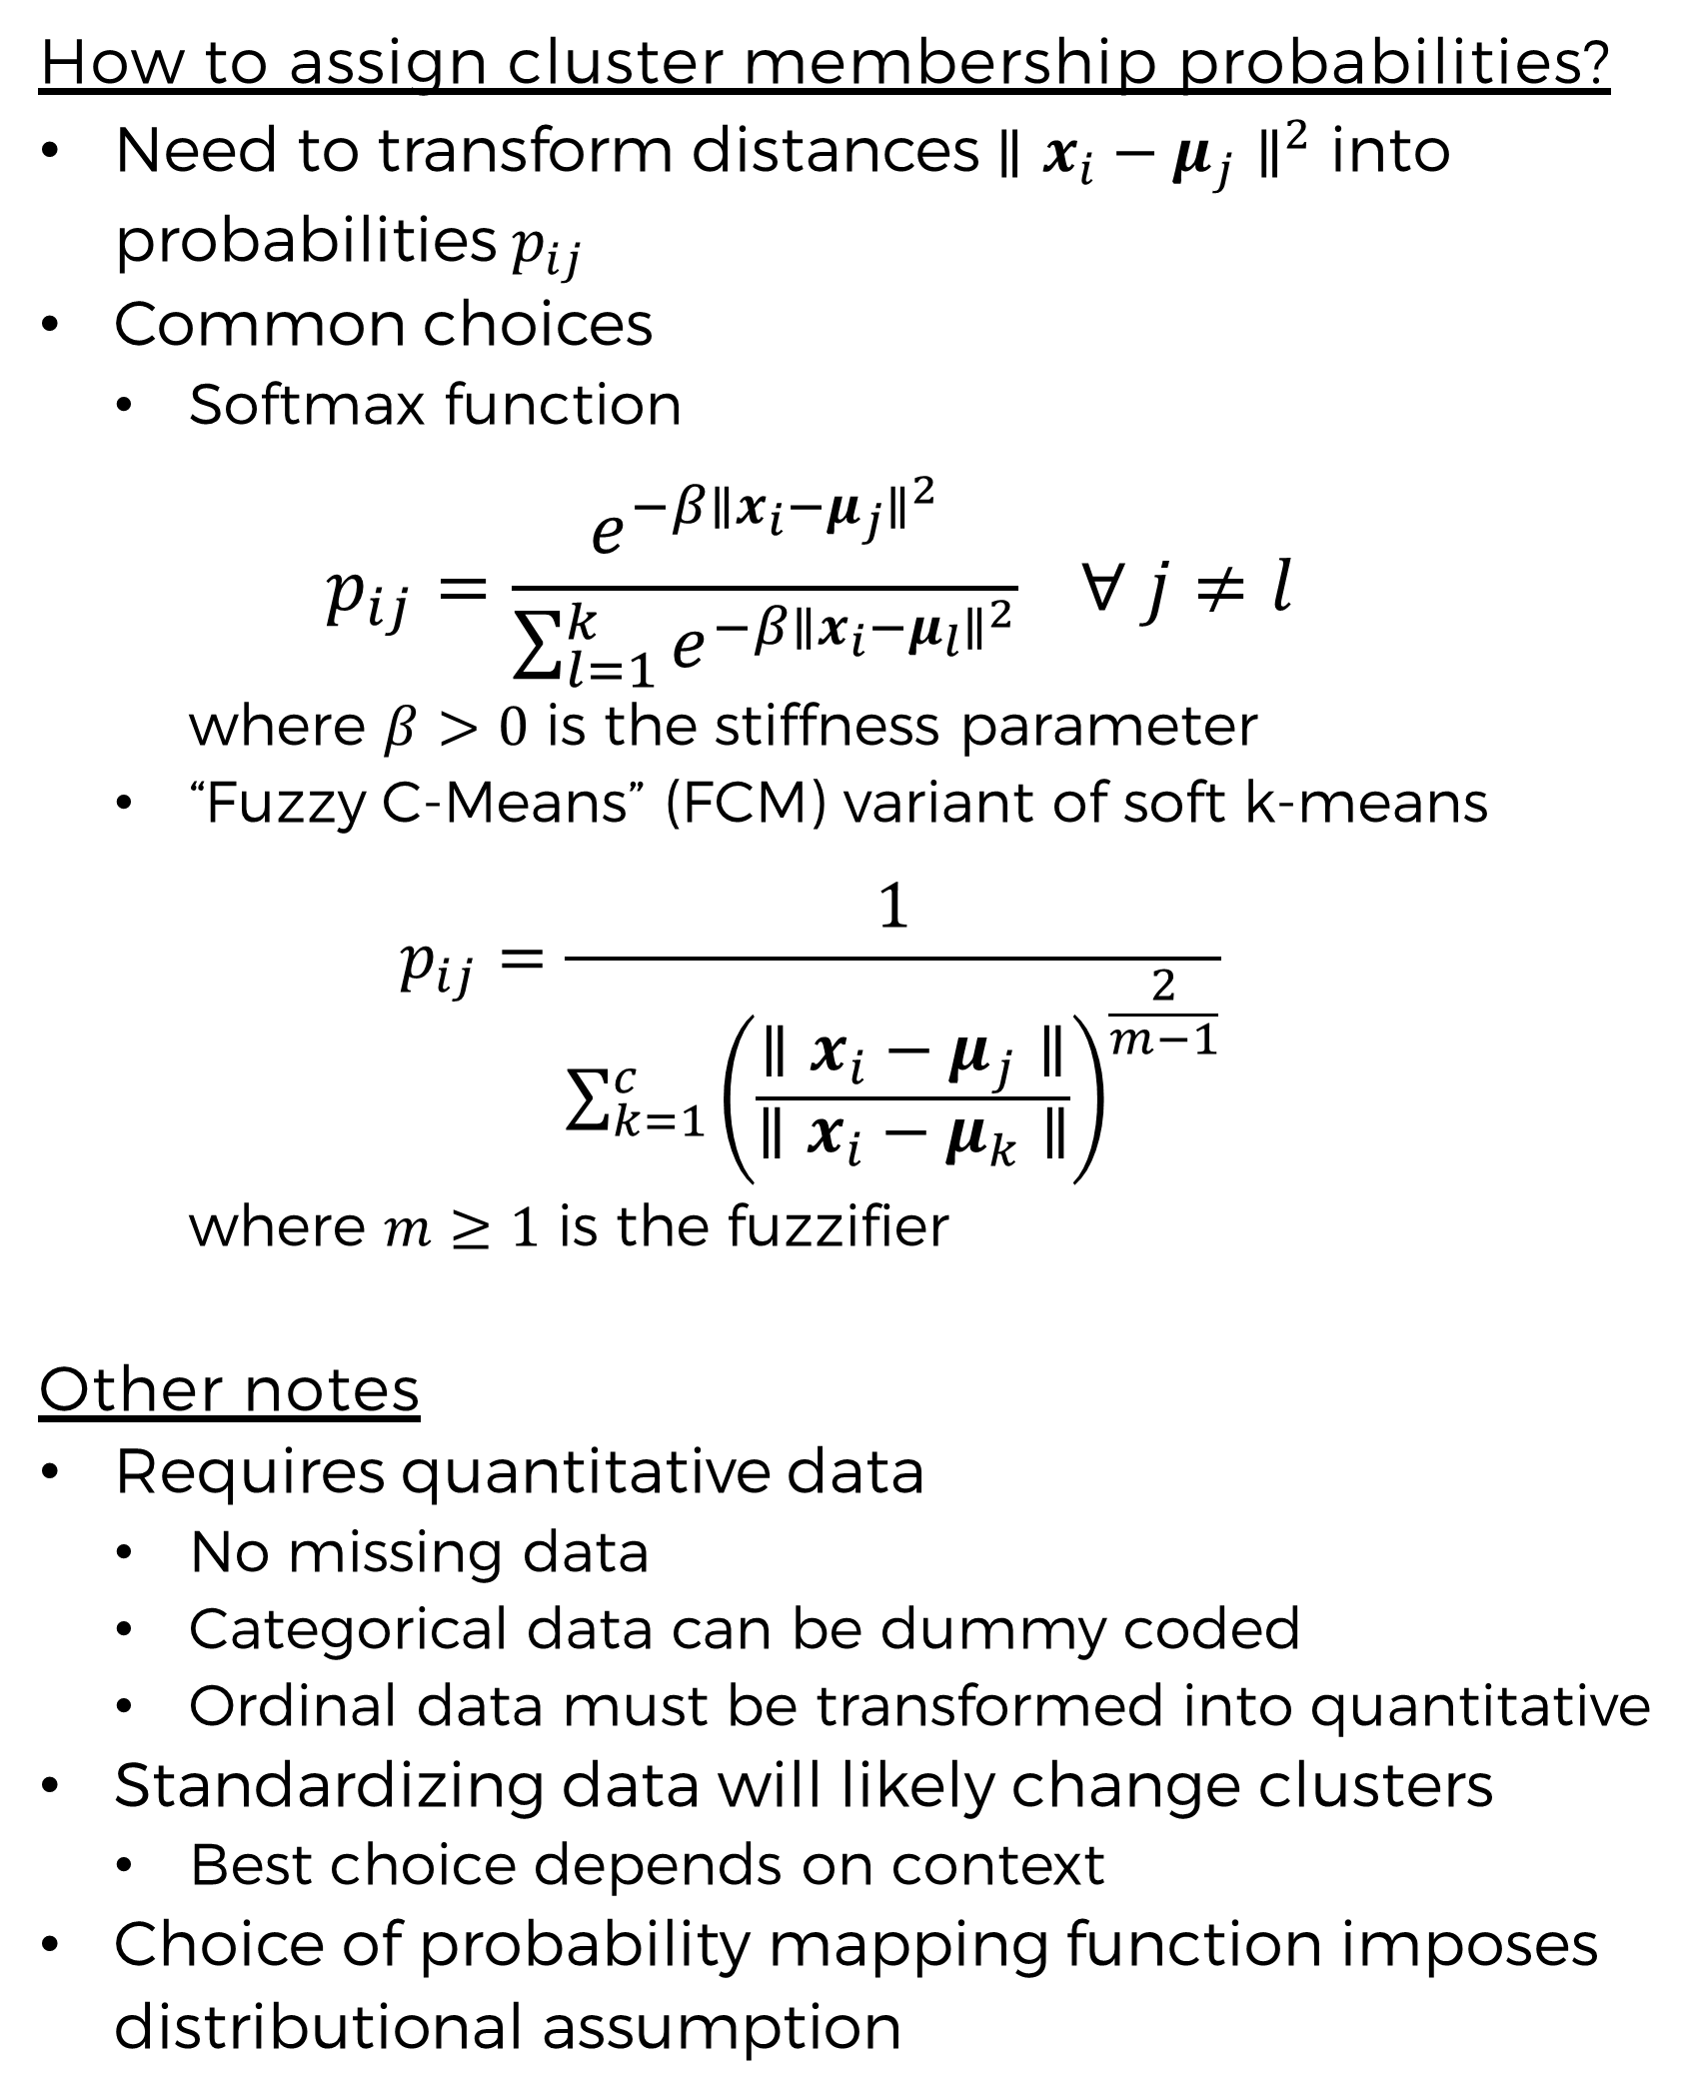
Soft K-Means Clustering:
Theory and Application with Uber Pickup Data from NYC
Evan Generoli
MATH 6388 - Statistical and Machine Learning, Dr. Hendricks, University of Colorado Denver
Introduction
Theory
Theory (continued)
Results
Unsupervised learning techniques like clustering have become more popular in recent years
Standard clustering approaches like k-means impose that observations belong to only one cluster
May not be optimal for many applications because cluster boundaries are often unclear
Soft k-means relaxes this assumption, assigns each observation a degree of membership to each cluster
Cluster membership degrees are calculated so as to be interpretable as probability of membership in a cluster
Better deals with bordering points for which cluster membership is unclear
Standard K-means Clustering Review
Partitions data into groups of similar datapoints
Uses squared Euclidean distance
Chooses cluster centroids$μ_{1},μ_{2},…, μ_{k}$ to minimize within cluster scatter
$$L=\sum_{j=1}^{k}{\sum_{x_{i}∈C_{j}}{∥x_{i}−μ_{j}∥^{2}}}=\sum_{j=1}^{k}{\sum_{i=1}^{n}{z_{ij}∥x_{i}−μ_{j}∥^{2} }}$$
where $z_{ij}$ are cluster membership indicators
$$z_{ij}=\left\{\begin{aligned}1, if x_{i}∈C_{j} \\ 0, otherwise\end{aligned}\right.$$
Finding global optimum generally not computationally feasible
K-means algorithm uses greedy, iterative descent to find local minimum
Randomly choose initial centroids $μ_{1},μ_{2},…, μ_{k}$
Iterate until clusters stabilize:
Assign datapoints to nearest centroid’s cluster
$$z_{ij}= \left\{\begin{aligned}1, if ∥x_{i}−μ_{j}∥^{2} ≤ ∥x_{i}−μ_{l}∥^{2} ∀ j≠l \\ 0, otherwise \end{aligned}\right.$$
Update cluster centroids
$μ_{j}=\frac{1}{|C_{j}|}\sum_{x_{i}∈C_{j}}{x_{i}}=$ $\frac{\sum_{i=1}^{n}{z_{ij}x_{i}}}{\sum_{i=1}^{n}{z_{ij}}}$
Soft K-means Clustering
Cluster assignments no longer “hard”
$⟹$ Cluster membership “indicators” no longer binary
Datapoints $x_{i}$ are assigned cluster membership probabilities $p_{ij}$
Seeks to choose cluster centroids $μ_{1},μ_{2},…, μ_{k}$ to minimize loss function
$$L= \sum_{j=1}^{k}{\sum_{i=1}^{n}{p_{ij}∥x_{i}−μ_{j}∥^{2} }}$$
Finding global optimum generally not feasible
Soft K-means algorithm (iterative descent)
Randomly choose initial centroids $μ_{1},μ_{2},…, μ_{k}$
Iterate until clusters stabilize:
Compute cluster membership probabilities
$p_{ij}∈[0,1]$ & $\sum_{j=1}^{k}{p_{ij}=1}$
Update cluster centroids as weighted mean of all $x_{i}$
$$μ_{j}=\frac{\sum_{i=1}^{n}{p_{ij}x_{i}}}{\sum_{i=1}^{n}{p_{ij}}}$$
where weights are membership probabilities for each $x_{i}$ & cluster $j$
How to assign cluster membership probabilities?
Need to transform distances $∥x_{i}−μ_{j}∥^{2}$ into probabilities $p_{ij}$
Common choices
Softmax function
$$p_{ij}=\frac{e^{−β∥x_{i}−μ_{j}∥^{2}}}{\sum_{l=1}^{k}{e^{−β∥x_{i}−μ_{l}∥^{2}}}} ∀ j≠l$$
where $β>0$ is the stiffness parameter
“Fuzzy C-Means” (FCM) variant of soft k-means
$$p_{ij}=\frac{1}{\sum_{k=1}^{c}{{\left(\frac{∥x_{i}−μ_{j}∥}{∥x_{i}−μ_{k}∥}\right)}^{\frac{2}{m−1}}}}$$
where $m≥1$ is the fuzzifier
Other notes
Requires quantitative data
No missing data
Categorical data can be dummy coded
Ordinal data must be transformed into quantitative
Standardizing data will likely change clusters
Best choice depends on context
Choice of probability mapping function imposes distributional assumption
Case Study
Dataset: Uber pickups in NYC, 2014
Available on Kaggle
Contains Latitude & Longitude data
Sample size: n = 4,534,327
Methodology
Take random sample of 30,000 observation (all the R function could handle)
Use only latitude and longitude information
Apply FCM variant of soft clustering w/ 5 clusters
Goals
Compare 5 clusters to NYC boroughs
Plot on map of NYC to visualize fuzzy cluster “borders”
Figure 1, Motivating Example:
A general two dimensional example of when boundaries between clusters are unclear.
Figure taken from Bauckhage, 2015¹
Figure 2, Results
Fuzzy clusters plotted on maps of NYC with borough map for comparison
Borough Map taken from: NYCMap360²
References
Conclusion
Bauckhage, Christian. (2015). Lecture Notes on Data Science: Soft k-Means Clustering
NYCMap360. New York City Boroughs & Neighborhoods Map. https://nycmap360.com/nyc-boroughs-map#.XEZ1M1xKg2x
Clusters don’t match boroughs very well
Fuzzy cluster boundaries seem to match reality better than crisp ones
Neighborhoods & associated subcultures don’t have hard boundaries, fade gradually into one another
Soft k-means is more computationally intensive than standard k-means
Can’t handle as large of datasets

